Slide 1
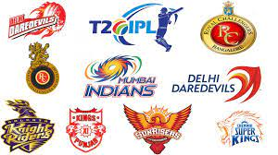
Indian Premier League

Slide 2
Indian Premier League
The Indian Premier League, or IPL, is a T20 cricket league, which was founded in 2008 and is held every year. It sees participation from both national and international players, and eight teams representing eight Indian cities compete with each other in a double round-robin format in the league stages, which are followed by playoffs. Over the years, IPL has become one of the most-watched and most attended live sporting events all over the world.

Slide 3
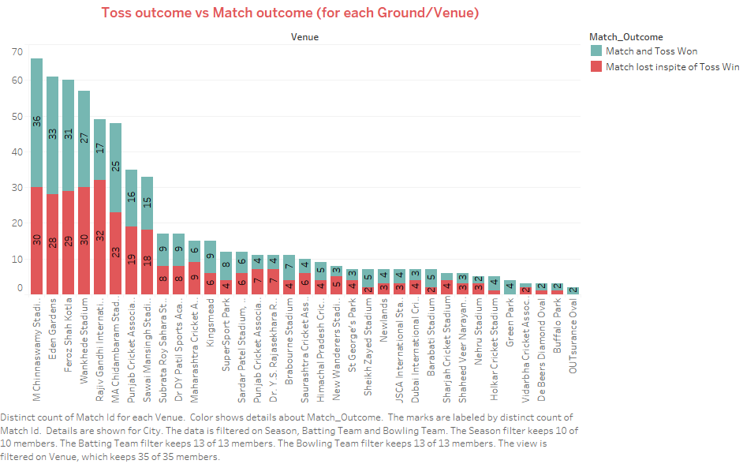
Toss outcome Vs Match outcome

Slide 4
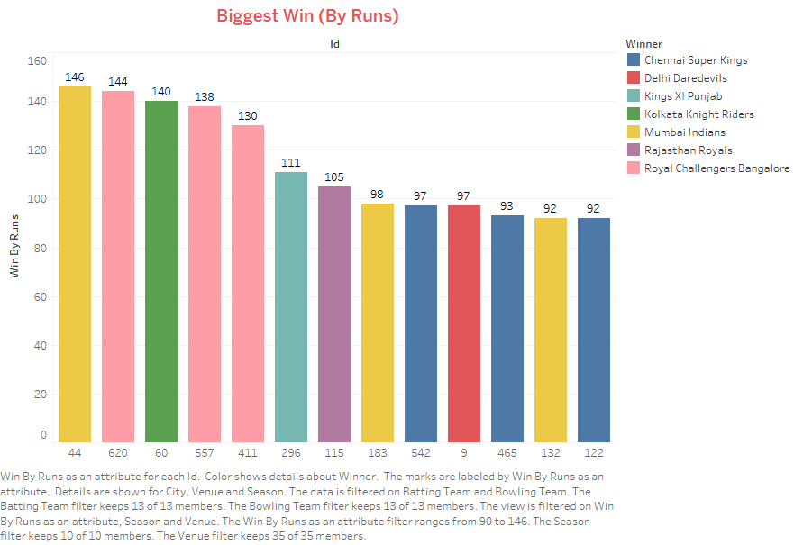
Biggest Win By Runs

Slide 5
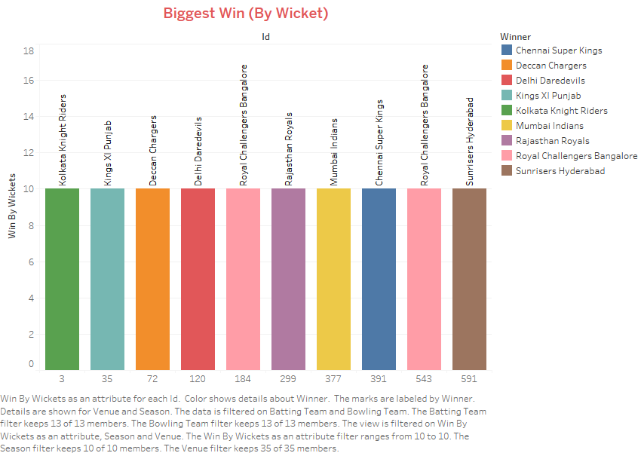
Biggest Win By Wicket

Slide 6
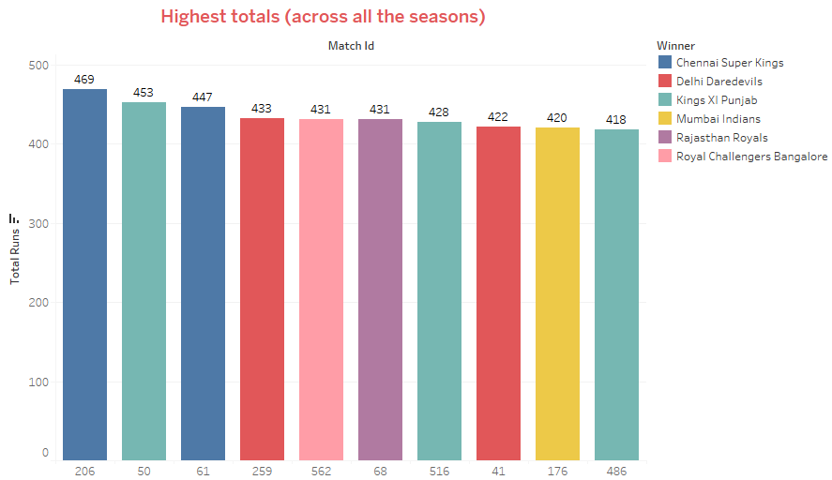
Highest totals

Slide 7
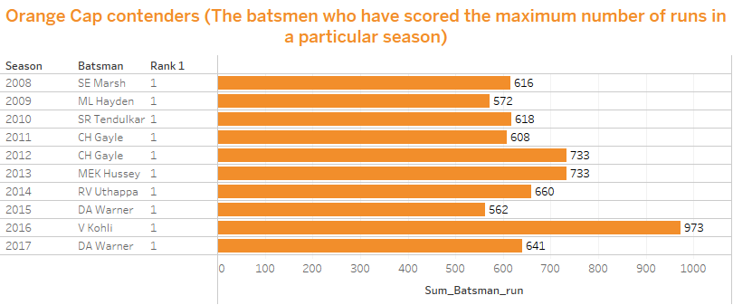
Orange Cap contenders

Slide 8
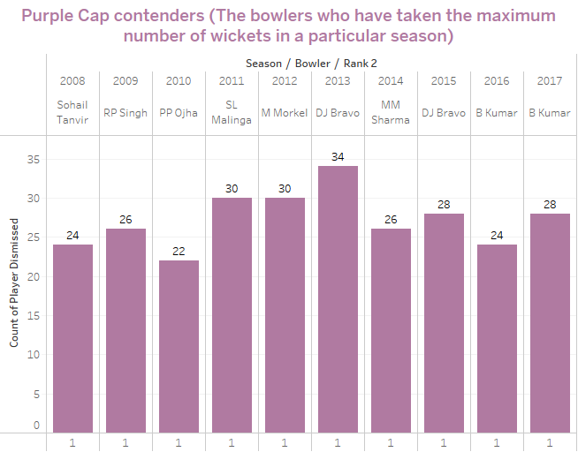
Purple Cap contenders

Slide 9
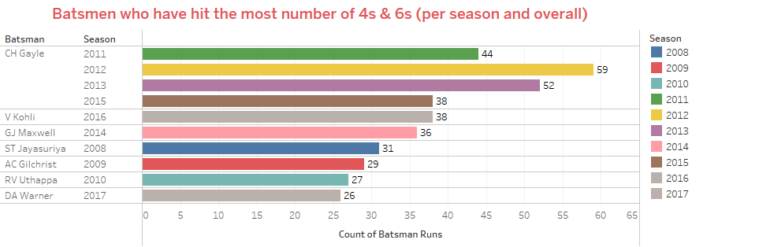
Most No. of 4s & 6s

Slide 10
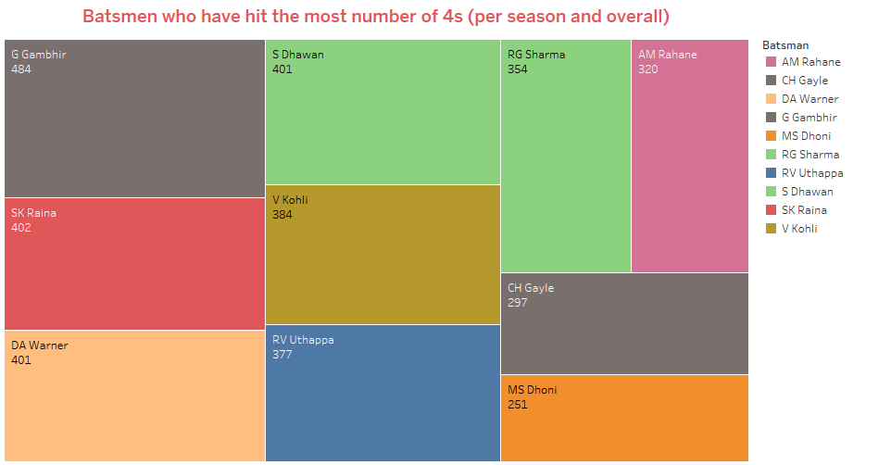
Most No. of 4s

Slide 11
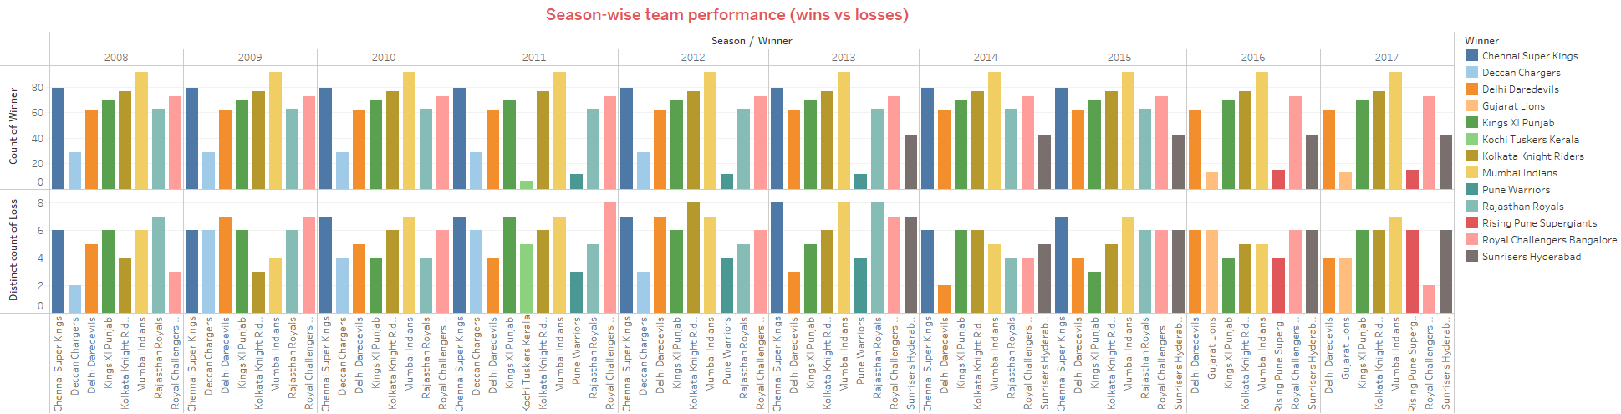
Season-wise team performance

Slide 12
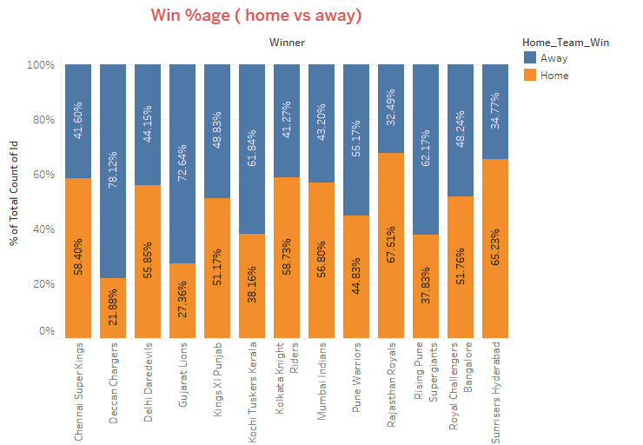
Win %age

Slide 13
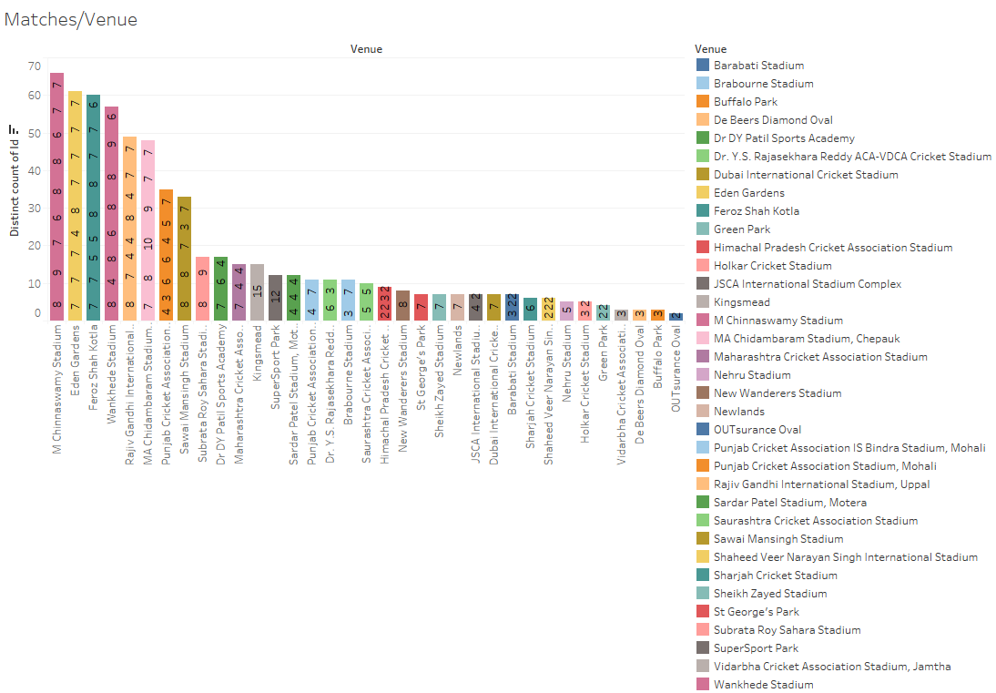
Match Vs Venue

Slide 14
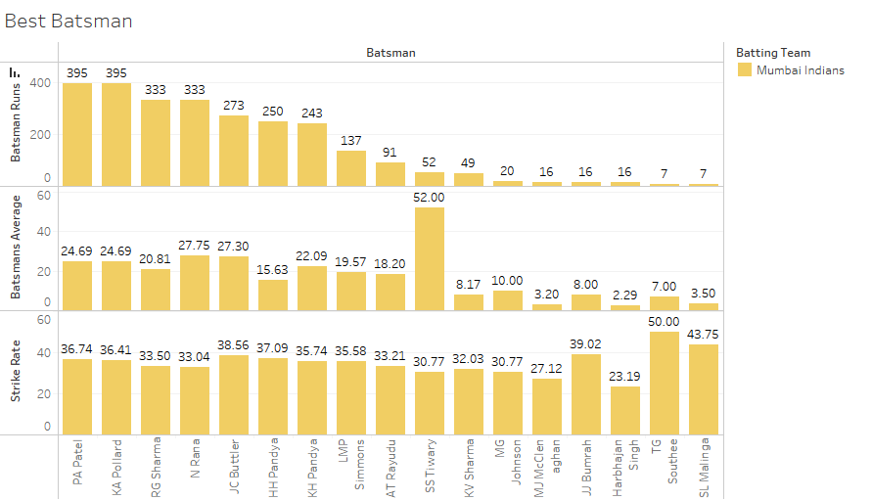
Best Batsman

Slide 15
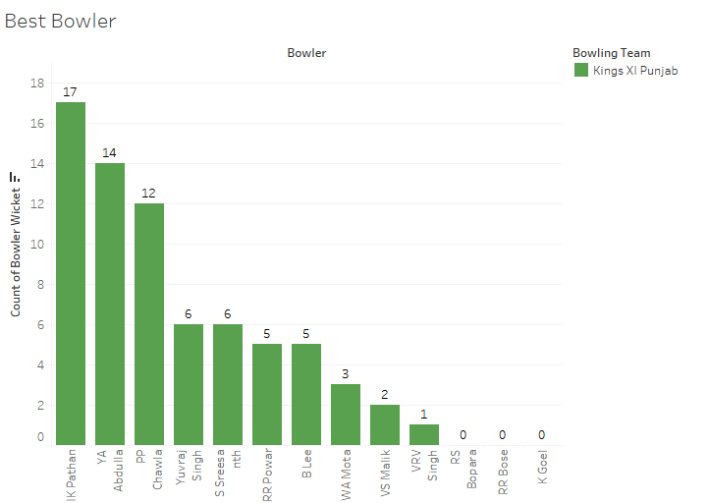
Best Bowler

Slide 16
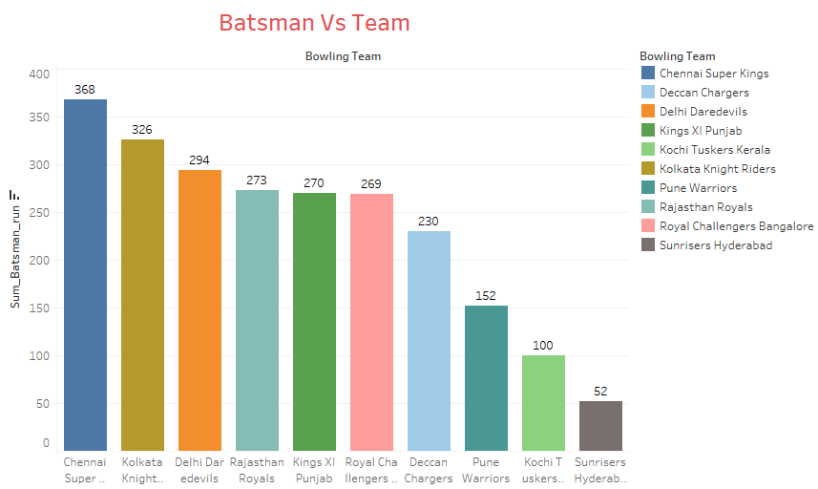
Batsman vs Team

Slide 17
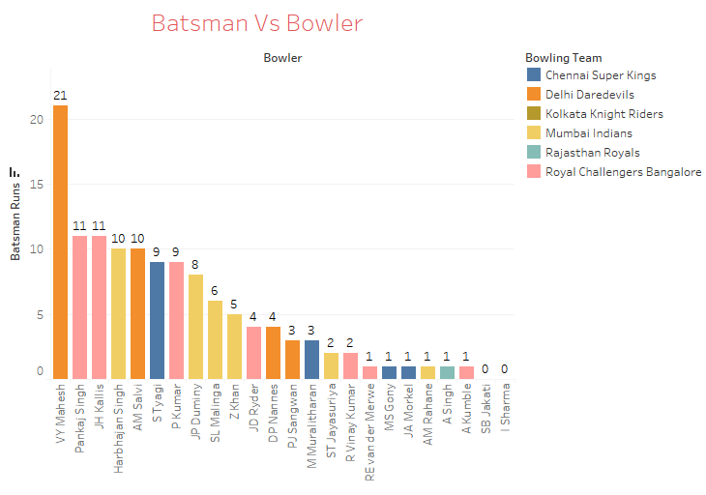
Batsman vs Bowler

Slide 18
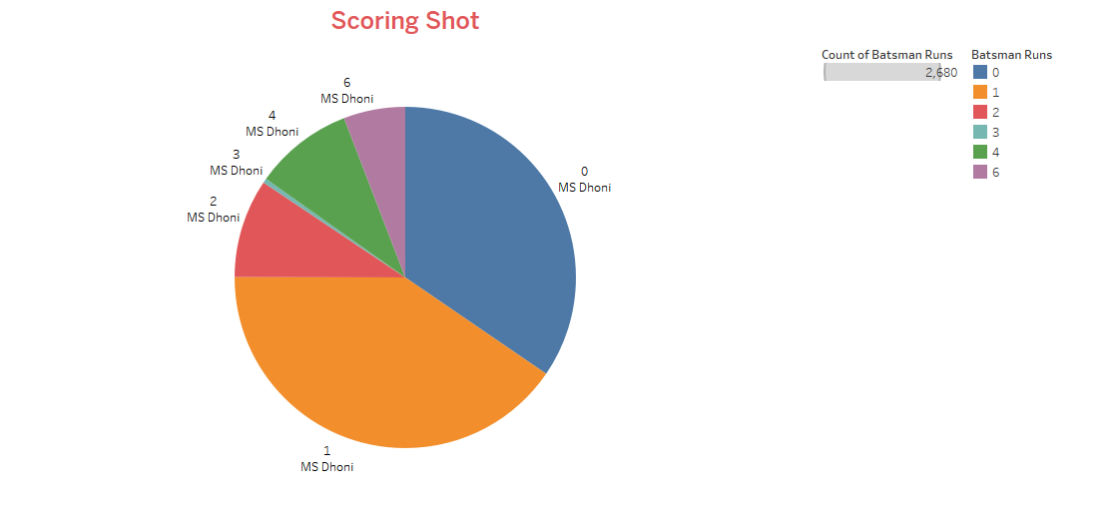
Scoring Shot

Slide 19
Thank You!!!

